Slide 1

project data Mining: (Association Rules)
Student:
Hasan Alomari
Mohammad NoorAldeen

Slide 2
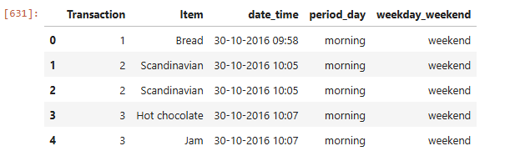
Transaction | Item | date_time | period_day | Weekend_weekday
1 | Bread | 30-10-2016 | morning | weekend
7992 | Tea | 11/3/2017 | evening | weekend
9636 | Cake | 8/4/2017 | afternoon | weekend
5859 | Soup | 30-10-2016 | afternoon | weekday
The data is the sales of a coffee shop in UK during half a year. contains 5 columns and 20500 records and 9000 Transaction. 1-Transaction: Unique identifier for each transaction
2-item: product name
3-date_time: date and time for each Transaction
4-period_day: period in day(morning)
5-weekend_weekday: weekend or weekday

Slide 3
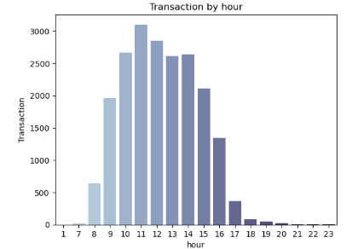
Data preprocessing
-Data Exploration:
-Checking the kind of data:
-Columns
-data type for each column
-Data cleaning:
-handling missing values: check any
null values in data.

Slide 4
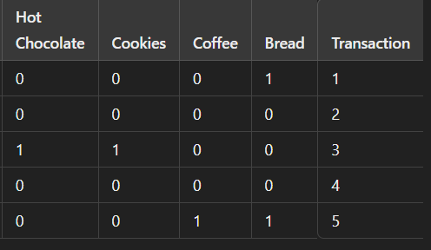
Data preprocessing
-Data transformation:
encoding : transform categorical data into a binary format (1.0),
Needed to use an encoding in this algorithm.

Slide 5

Model and algorithm
-ways to extract the associated rules:
-Apriori algorithm: If a set of items are
frequent in the data, then all sub-items are frequent.
-frequent item is identified by min support.
Min support ≥ num_frequent_item
Min support ≤ num_frequent_item
(non frequent)

Slide 6
Model and algorithm
In first:
All data is converted to 0 and 1 encoder for easy execution
In second:
The algorithm applied to data any element that does not meet the min support condition is removed.
In third:
Need defined confidence to generate rules.

Slide 7
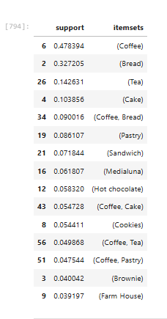
Model and algorithm
After implementing the encoding, we will apply the Apriori algorithm to the data, and set min_support = 0.02, and we will get this result .
- 33 Items were extracted from the algorithm out of 94 Items

Slide 8
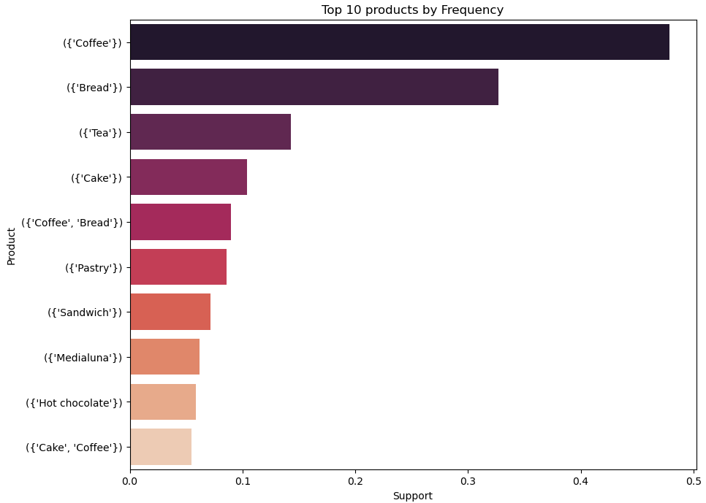
Model and algorithm
After implementing the encoding, we will apply the Apriori algorithm to the data, and set min_support = 0.02, and we will get this result.

Slide 9
Now, after implementing the Apriori algorithm, we will apply association rules to extract the rules and Support, Confidence, lift :
Items | Support | Confidence | Lift
(Toast) → (Coffee) | 0.023666 | 0.704403 | 1.47243
(Medialuna) → (Coffee) | 0.035182 | 0.569231 | 1.18988
(Pastry) → (Coffee) | 0.047544 | 0.552147 | 1.15417
(Juice) → (Coffee) | 0.020602 | 0.534247 | 1.11675
(Sandwich) → (Coffee) | 0.038246 | 0.532353 | 1.11279
(Cake) → (Coffee) | 0.054728 | 0.526958 | 1.10152
(Cookies) → (Coffee) | 0.028209 | 0.518447 | 1.08372
(Hot chocolate) → (Coffee) | 0.029583 | 0.507246 | 1.06031
(Tea) → (Coffee) | 0.049868 | 0.349630 | 0.73084
(Pastry) → (Bread) | 0.029160 | 0.338650 | 1.03498

Slide 10
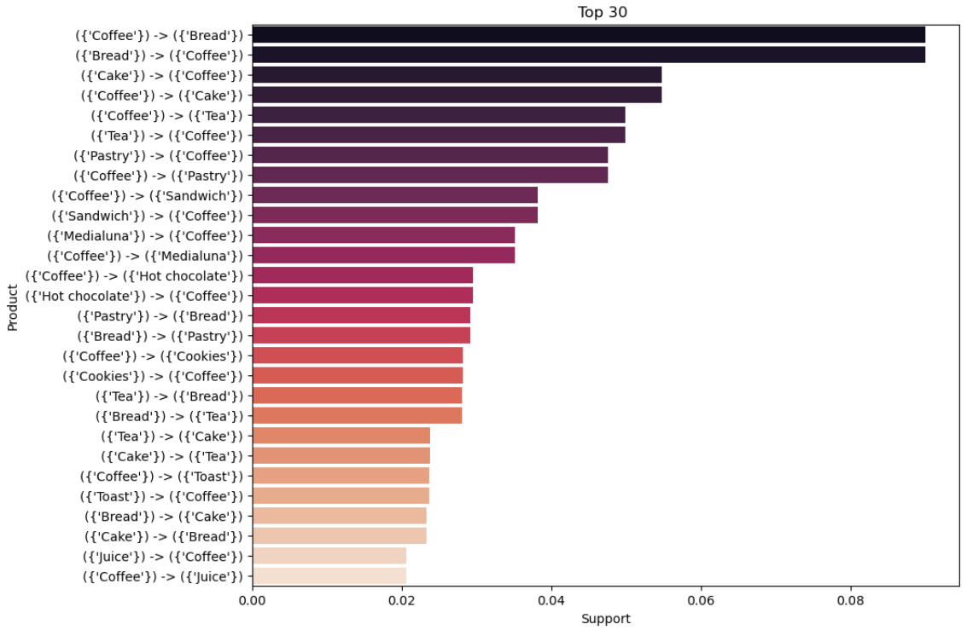
Results and analysis

Slide 11
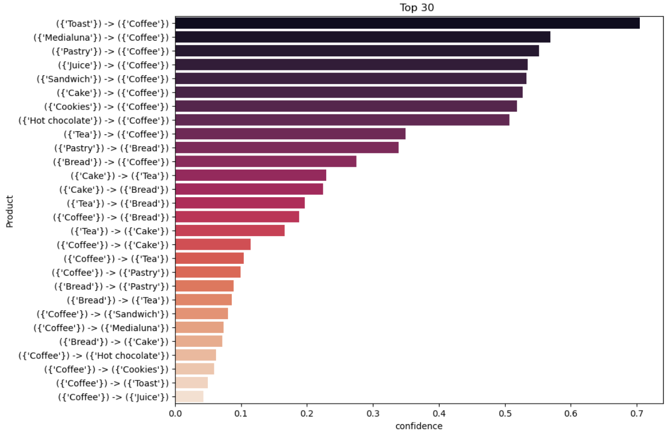
Results and analysis

Slide 12
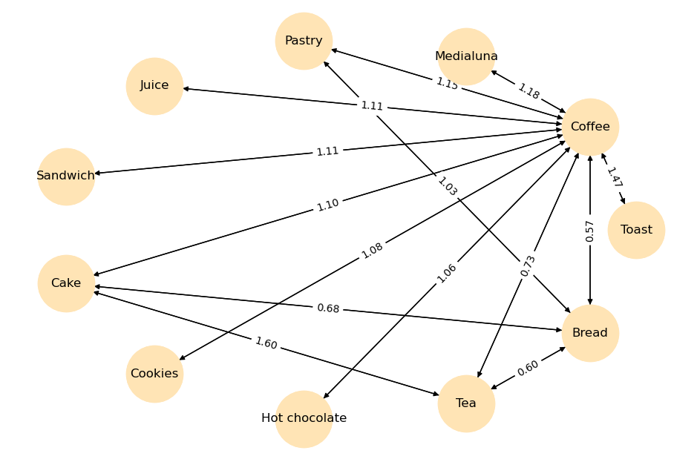
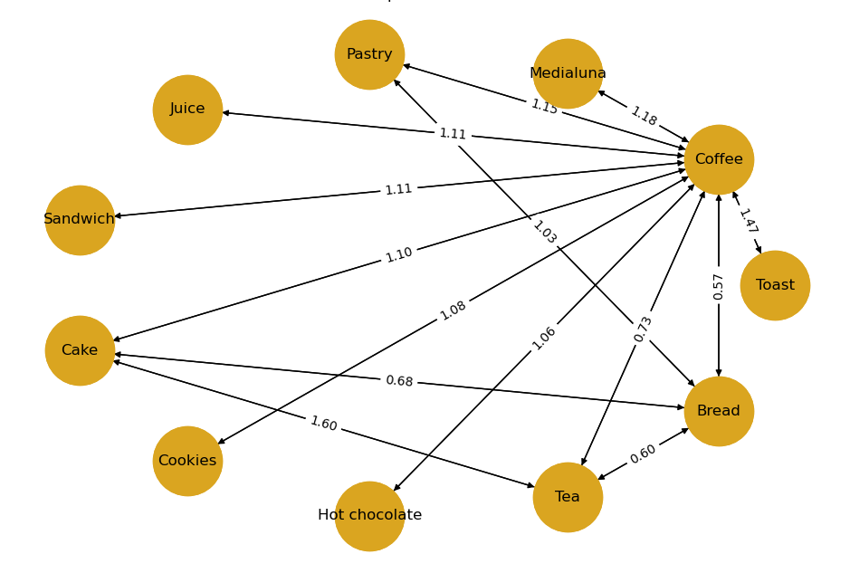
Results and analysis
.

Slide 13
Model evaluation
The most common rules together are that support and confidans and Lift.
Items | Support | Confidans | Lift
(Cake) → (Coffee) | 0.05 | 0.52 | 1.10
(pastry) → (Coffee) | 0.04 | 0.55 | 1.15
(Toast) → (Coffee) | 0.02 | 0.70 | 1.4
(Medialuna) → (Coffee) | 0.03 | 0.56 | 1.18

Slide 14
Model evaluation
After we decreased the value of support, we now have bases that have little support and have high confidence and lift . We concluded from these bases that it is a commercial opportunity if their positions are close together.
Ex:
(Spanish) →(Coffee) | 0.002 | 0.73 | 1.52
(Tea) → (Hot chocolate) | 0.002 | 0.014 | 0.47

Slide 15

reference
https://www.kaggle.com/datasets/mittalvasu95/the-bread-basket/data
https://github.com/prasertcbs/basic-dataset/blob/master/bread%20basket.csv

